Slide 1
CS4038
DATA MINING
LECTURE # 17
SPRING 2024
FAST – NUCES, CFD CAMPUS
AYESHA LIAQAT
ayesha.liaqat@nu.edu.pk

Slide 2
TODAY’S TOPICS
Data similarity & dissimilarity measures

Slide 3
DATA MATRIX AND DISSIMILARITY MATRIX
... x_{1f} ...
... ... ...
⎢ ... x_{if} ...
... ... ... ...
... x_{nf} ...
Data (or Object) matrix
n data points with p dimensions
^{⎡ x}11
^{x}1p ⎤
⎢ ...
... ⎥
⎢
⎥
^{⎢ x}i1
^{x}ip ⎥
⎥
...
⎢
⎥
^{⎢ x}n1
^{x}np ⎥
⎢⎣
⎥⎦
Dissimilarity matrix
n data points x n data points
n data points, but registers only the distance
A triangular matrix
⎡
0
⎤
⎥
⎥
⎥
⎥
⎥
₀⎥⎦
⎢ d(2,1) 0
⎢
⎢ d(3,1) d (3,2) 0
⎢ : : :
d (n,2) ...
⎢
⎣⎢d (n,1)
...

Slide 4
SIMILARITY AND DISSIMILARITY MEASURES
Similarity measure
Numerical measure of how alike two data objects are.
Is higher when objects are more alike.
Often falls in the range [0,1]
Dissimilarity measure
Numerical measure of how different two data objects are
Lower when objects are more alike
Minimum dissimilarity is often 0
Upper limit varies
Distance is used as a synonym for dissimilarity
Proximity refers to a similarity or dissimilarity measure

Slide 5
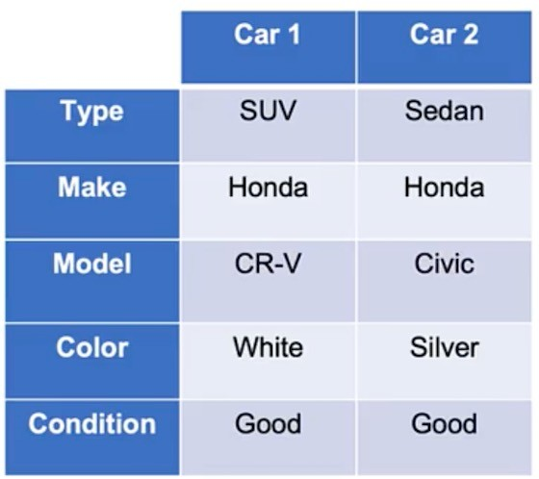
NOMINAL ATTRIBUTES
Similarity
s = 1 if x = y; otherwise s = 0
Dissimilarity
d = 0 if x = y; otherwise d = 1
Customized
E.g., color: white is more similar to silver than red

Slide 6
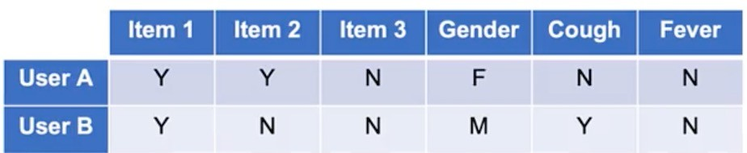
BINARY ATTRIBUTES
Similarity measures between objects that contain only binary attributes are called
similarity coefficients and typically lie between 0 and 1.
Symmetric: equal chance of Y or N
Same calculations as nominal
E.g., Simple matching (no. of matched bits), Hamming distance (no. of bits that are different)
Asymmetric: Y is less likely than N
E.g., items purchased or medical symptoms

Slide 7
SIMILARITY BETWEEN BINARY ATTRIBUTES
Compute similarities using the following quantities
f₀₁ = the number of attributes where x was 0 and y was 1 f₁₀ = the number of attributes where x was 1 and y was 0 f₀₀ = the number of attributes where x was 0 and y was 0 f₁₁ = the number of attributes where x was 1 and y was 1
Simple Matching Coefficient: SMC = number of matches / number of attributes
= (f₁₁ + f₀₀) / (f₀₁ + f₁₀ + f₁₁ + f₀₀)
Jaccard Coefficient: J
= number of presence matches / number of non-zero attributes
= (f₁₁) / (f₀₁ + f₁₀ + f₁₁)

Slide 8
EXAMPLE: SMC VS. JACCARD COEFFICIENT
x = 1 0 0 0 0 0 0 0 0 0
y = 0 0 0 0 0 0 1 0 0 1
f₀₁ = 2
f₁₀ = 1
f₀₀ = 7
f₁₁ = 0
(the number of attributes where x was 0 and y was 1) (the number of attributes where x was 1 and y was 0) (the number of attributes where x was 0 and y was 0) (the number of attributes where x was 1 and y was 1)
SMC = (f₁₁ + f₀₀) / (f₀₁ + f₁₀ + f₁₁ + f₀₀)
= (0+7) / (2+1+0+7) = 0.7
J = (f₁₁) / (f₀₁ + f₁₀ + f₁₁)
= 0 / (2 + 1 + 0) = 0
Notes:
SMC is not good for imbalanced distributions/datasets

Slide 9
DISSIMILARITY BETWEEN BINARY ATTRIBUTES
Hamming distance
Distance measure for symmetric binary variables:
d(x,y) = (f₀₁ + f₁₀) / (f₀₁ + f₁₀ + f₁₁ + f₀₀)
Distance measure for asymmetric binary variables:
d(x,y) = (f₀₁ + f₁₀) / (f₀₁ + f₁₀ + f₁₁)

Slide 10
DISSIMILARITY BETWEEN BINARY ATTRIBUTES
Example
Name | Gender | Fever | Cough | Test-1 | Test-2 | Test-3 | Test-4
Jack Mary Jim | M F M | Y Y Y | N N P | P P N | N N N | N P N | N N N
Gender is a symmetric attribute
The remaining attributes are asymmetric binary
Let the values Y and P be 1, and the value of N = 0
Dissimilarity for all asymmetric attributes
0 + 1
d ( jack, mary ) =
= 0.33
2 + 0 + 1
1 + 1
d ( jack, jim) =
= 0.67
1 + 1 + 1
1 + 2
d ( jim, mary ) =
= 0.75
1 + 1 + 2

Slide 11
ORDINAL ATTRIBUTES
An ordinal variable can be discrete or continuous
Order is important, e.g., rank
Can be treated like interval-scaled
replace x_{if} by their rank
r_{if} ∈{1,...,M _{f} }
map the range of each variable onto [0, 1] by replacing i-th object in the f-th
variable by:
r −1
z
₌ if
if
M _{f} −1
compute the dissimilarity using methods for interval-scaled variables
For interval or ratio attributes, dissimalrity between two objects is the absolute difference of their values.

Slide 12
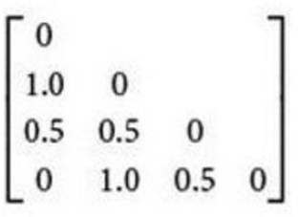
EXAMPLE: ORDINAL VARIABLES DISSIMILARITY
Student | Exam Performance | Rank | Rank’
1 | Excellent | 3 | 1.0
2 | Fair | 1 | 0.0
3 | Good | 2 | 0.5
4 | Excellent | 3 | 1.0
Attribute ‘Exam Performance’ has three states: Fair, Good and Excellent, M_{f} = 3
In step 1, the four attribute values are assigned the ranks (assumingly: 1 = Fair, 2 = Good and 3 = Excellent)
In step 2, these ranks are normalized in the range of 0-1, new mappings are: 1 to 0.0, 2 to 0.5 and 3 to 1.0
In step 3, calculate the dissimilarity between different students by taking absolute difference
We can now say that student 1 and 2 are quite dissimilar, as well as student 2 and 4
14

Slide 13
TRANSFORMATIONS
Transformations are often applied to convert a similarity to a dissimilarity, or vice versa, or to transform a proximity measure to fall within a particular range, such as [0,1].
For example: if similarities between objects range from 1 to 10, we can transform them to the 0- 1 range using:
s’ = (s-1) / 9
OR
s’ = (s-min_s) / (max_s – min_s)
Min-Max normalization
15

Slide 14
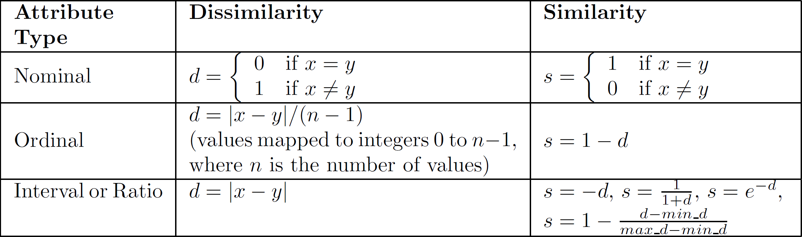
SIMILARITY/DISSIMILARITY FOR SIMPLE ATTRIBUTES
The following table shows the similarity and dissimilarity between two objects, x
and y, with respect to a single, simple attribute.

Slide 15
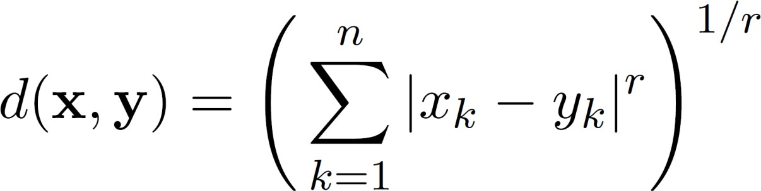
NUMERIC ATTRIBUTES
Usually measured by a distance function
Minkowski distance (l_p norm)
Where r is a parameter, n is the number of dimensions (attributes) and x_{k} and y_{k} are, respectively, the k^{th} attributes (components) or data objects x and y.
r = 1: Manhattan distance
r = 2: Euclidean distance

Slide 16
MINKOWSKI DISTANCE: EXAMPLES
r = 1. City block (Manhattan, taxicab, L₁ norm) distance.
A common example of this for binary vectors is the Hamming distance, which is just the number of bits that are different between two binary vectors
r = 2. Euclidean distance
r → ∞. “supremum” (L_{max} norm, L∞ norm, Chebyshev) distance.
This is the maximum difference between any component of the vectors
Do not confuse r with n, i.e., all these distances are defined for all numbers of dimensions.

Slide 17
EXAMPLE: MINKOWSKI DISTANCE
L1 | p1 | p2 | p3 | p4
p1 | 0 | 4 | 4 | 6
p2 | 4 | 0 | 2 | 4
p3 | 4 | 2 | 0 | 2
p4 | 6 | 4 | 2 | 0
point | x | y
p1 | 0 | 2
p2 | 2 | 0
p3 | 3 | 1
p4 | 5 | 1
L2 | p1 | p2 | p3 | p4
p1 | 0 | 2.828 | 3.162 | 5.099
p2 | 2.828 | 0 | 1.414 | 3.162
p3 | 3.162 | 1.414 | 0 | 2
p4 | 5.099 | 3.162 | 2 | 0
L∞ | p1 | p2 | p3 | p4
p1 | 0 | 2 | 3 | 5
p2 | 2 | 0 | 1 | 3
p3 | 3 | 1 | 0 | 2
p4 | 5 | 3 | 2 | 0
Distance Matrices

Slide 18
MANHATTAN (OR CITY BLOCK) DISTANCE
Manhattan Distance
𝑛
= & |𝑥𝑘 − 𝑦𝑘|
𝑘=1
𝑑 𝑥, 𝑦
where n is the number of dimensions (attributes) and x_{k} and y_{k} are, respectively, the k^{th} attributes (components) or data objects x and y.

Slide 19
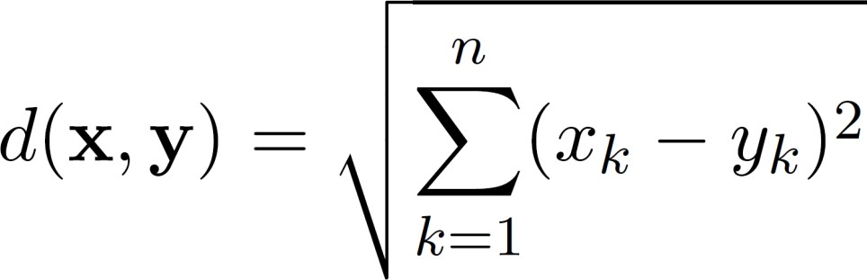
EUCLIDEAN DISTANCE
Euclidean Distance
where n is the number of dimensions (attributes) and x_{k} and y_{k} are, respectively, the k^{th} attributes (components) or data objects x and y.
Standardization is necessary, if scales differ.

Slide 20
EXAMPLE: EUCLIDEAN DISTANCE
point | x | y
p1 | 0 | 2
p2 | 2 | 0
p3 | 3 | 1
p4 | 5 | 1
3
2
p1
p3
p4
1
p2
0
 | p1 | p2 | p3 | p4
p1 | 0 | 2.828 | 3.162 | 5.099
p2 | 2.828 | 0 | 1.414 | 3.162
p3 | 3.162 | 1.414 | 0 | 2
p4 | 5.099 | 3.162 | 2 | 0
0 1
2 3 4
5 6
Distance Matrix

Slide 21
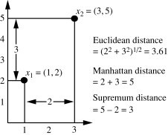
EXAMPLE: EUCLIDEAN & MANHATTAN DISTANCE
Let, x1 = (1,2), x2 = (3,5) represents two data objects.
Dissimilarity between the x and y can be computed by Euclidean or Manhattan distance.

Slide 22
MINKOWSKI DISTANCE
Minkowski Distance is a generalization of Euclidean and Manhattan Distance
Where r is a parameter, n is the number of dimensions (attributes) and x_{k} and y_{k} are, respectively, the k^{th} attributes (components) or data objects x and y.

Slide 23
COMMON PROPERTIES OF A DISTANCE
Distances, such as the Euclidean distance, have some well-known properties.
d(x, y) ≥ 0 for all x and y and d(x, y) = 0 if and only if x = y.
d(x, y) = d(y, x) for all x and y. (Symmetry)
d(x, z) ≤ d(x, y) + d(y, z) for all points x, y, and z. (Triangle Inequality)
where d(x, y) is the distance (dissimilarity) between points (data objects), x and
y.
A distance that satisfies these properties is a metric

Slide 24
COMMON PROPERTIES OF A SIMILARITY
Similarities, also have some well-known properties.
s(x, y) = 1 (or maximum similarity) only if x = y.
(does not always hold, e.g., cosine)
s(x, y) = s(y, x) for all x and y. (Symmetry)
where s(x, y) is the similarity between points (data objects), x and y.

Slide 25
COSINE SIMILARITY
Similarly, finding similarity between documents which are represented by vectors of words’ frequencies, we do not want to count 0-0 matches of words not present in either of the document.
Something like Jaccard coefficient, but the similarity measure for documents must be able to handle non-binary vectors. Cosine similarity is the most used measure for document vectors.
Angular similarity of vectors: inner product

Slide 26
COSINE SIMILARITY
If d₁ and d₂ are two document vectors, then
cos( d₁, d₂ ) = d₁・d₂ / ||d₁|| ||d₂|| ,
where d₁・d₂ indicates inner product or vector dot product of vectors, d₁ and d_{2,} and || d || is the length of vector d.
Example:
d₁ = 3 2 0 5 0 0 0 2 0 0 d₂ = 1 0 0 0 0 0 0 1 0 2
d₁・d2 = 3*1 + 2*0 + 0*0 + 5*0 + 0*0 + 0*0 + 0*0 + 2*1 + 0*0 + 0*2 = 5
|| d₁ || = (3*3+2*2+0*0+5*5+0*0+0*0+0*0+2*2+0*0+0*0)^{0.5} = (42) ^{0.5} = 6.481
|| d₂ || = (1*1+0*0+0*0+0*0+0*0+0*0+0*0+1*1+0*0+2*2) ^{0.5} = (6) ^{0.5} = 2.449 cos(d₁, d₂ ) = 0.3150

Slide 27
READING MATERIAL
Chapter 2:Tan, Steinbach & Kumar
Chapter 10: Han, Kamber & Pei
An article on distance measures:
https://towardsdatascience.com/17-types-of-similarity-and-dissimilarity-measures-used- in-data-science-3eb914d2681
39

